Slide 1
Marketplace Lending
Traci Mach*
Board of Governors of the Federal Reserve System
*The opinions expressed are those of the author and do not necessarily represent those of the Board of Governors or its staff.

Slide 2
What is Marketplace Lending?
A method of debt financing that enables individuals to borrow and lend money - without the use of an official financial institution as an intermediary.

Slide 3
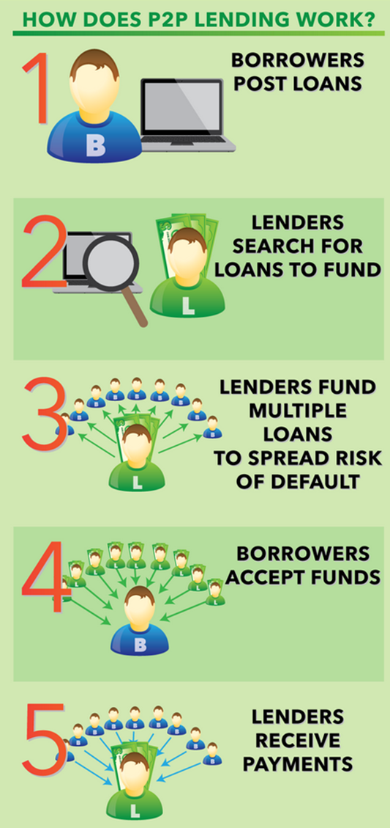
How marketplace lending works
Borrower chooses a platform
Borrower posts a loan listing, describing how much he/she would like to borrow and what the proceeds will be used for
Platform evaluates the credit-worthiness of the borrower
Investors browse listings and choose which loans they would like to invest in
Fully funded loans are disbursed by the platform to the borrower
Borrower makes payments to the platform, which distributes repayment among investors

Slide 4
Two largest players in US market: Lending Club & Prosper

Slide 5
Who can borrow money?
 | Lending Club | Prosper
Minimum credit score | 600 | 640
States not available for borrowers | IA | IA, ME, ND
Loan amount range | $1,000-$40,000 | $2,000-$35,000
Origination fee range | 1% – 6% by loan grade | 2% – 5% by loan grade
Loan terms | 3 and 5 years | 3 and 5 years
APR range | 5.99% - 35.89% | 5.99% - 36.00%

Slide 6
Who can lend money
 | Lending Club | Prosper
States where lending is not allowed | None: OH Trading only: HI, NC, NM, PA | AL, AR, AZ, IA, KS, KY, MA, NE, NC, ND, MD, NJ, NM, OH, OK, PA, TN, TX
Income and wealth requirements | (a) an annual gross income of at least $70,000 and a net worth (exclusive of home, home furnishings and automobile) of at least $70,000; or (b) have a net worth of at least $250,000 (determined with the same exclusions). | In AK, ID, MO, NV, NH, VA, and WA: (a) have an annual gross income of at least $70,000 and a net worth (exclusive of home, home furnishings, and automobile) of at least $70,000; or (b) have a net worth (determined with the same exclusions) of at least $250,000.
Servicing fee | 1% | 1%

Slide 7
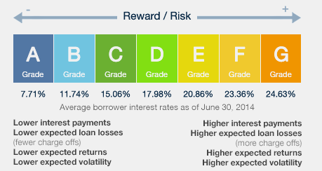
Platform assesses the potential borrower’s risk and assigns a grade

Slide 8
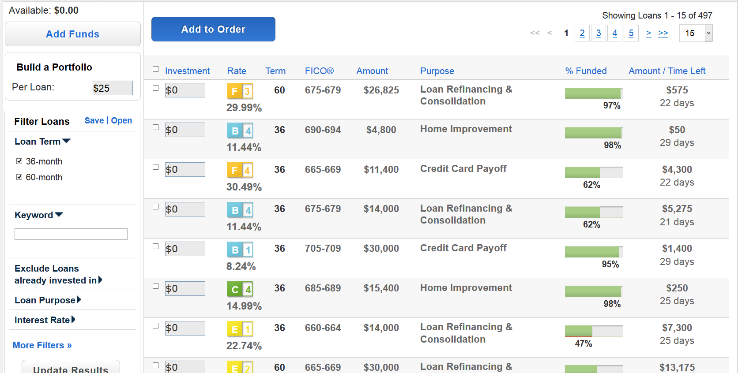
Platform posts accepted offerings on its site for lenders to review

Slide 9
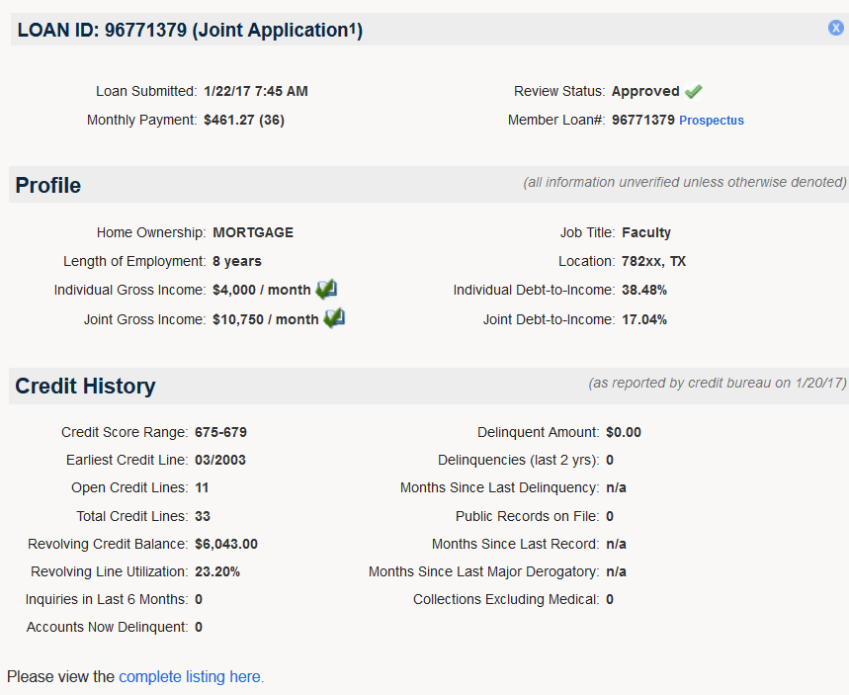
A deeper look at the loan

Slide 10
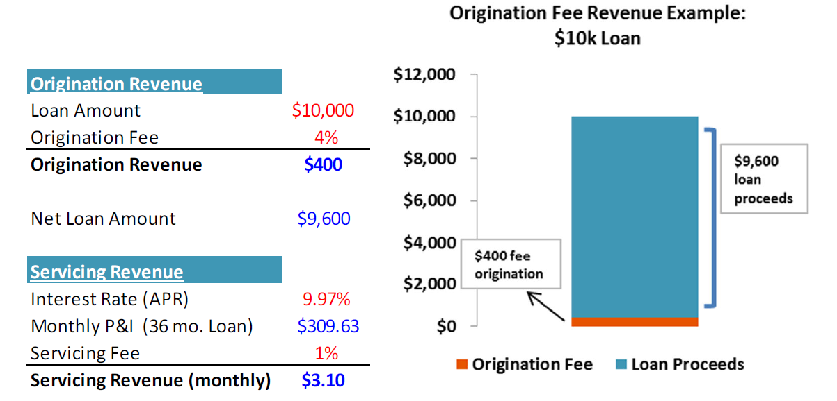
A simple example

Slide 11
Lending Club Applications by Funding Status
.9M funded, 6.3M unfunded

Slide 12
Lending Club Applications by Funding Status
$13B funded, $93B unfunded

Slide 13
Lending Club Applications by Funding Status

Slide 14
A closer look at the unfunded applications

Slide 15
What are the unfunded applications for?

Slide 16
Where are the unfunded applicants?

Slide 17
Applications over time
 | Number | Average | Median | 75th percentile
2007 | 5,277 | 8,537 | 6,000 | 12,000
2008 | 25,622 | 8,611 | 7,000 | 12,000
2009 | 57,026 | 10,330 | 8,500 | 15,000
2010 | 112,641 | 11,055 | 9,000 | 17,000
2011 | 217,863 | 12,889 | 10,000 | 20,000
2012 | 337,060 | 14,348 | 10,000 | 22,000
2013 | 760,025 | 13,229 | 10,000 | 20,000
2014 | 1,929,158 | 12,109 | 9,000 | 20,000
2015 | 2,850,596 | 12,945 | 10,000 | 20,000

Slide 18
Risk score of unfunded applications
 | Mean | Median | 75th percentile
2007 | 550 | 570 | 643
2008 | 572 | 605 | 667
2009 | 578 | 629 | 686
2010 | 583 | 647 | 692
2011 | 579 | 642 | 687
2012 | 605 | 648 | 683
2013 | 611 | 646 | 681
2014 | 633 | 637 | 677
2015 | 637 | 641 | 677

Slide 19
Debt-to-income ratio of unfunded applications
 | Mean | Median | 75th percentile
2007 | 21 | 15 | 28
2008 | 27 | 17 | 34
2009 | 31 | 20 | 39
2010 | 24 | 18 | 33
2011 | 23 | 17 | 31
2012 | 23 | 18 | 32
2013 | 24 | 19 | 34
2014 | 33 | 22 | 43
2015 | 32 | 22 | 42

Slide 20
A quick look at small business applications

Slide 21
Unfunded requested funds

Slide 22
Unfunded business applications by age of business

